Slide 1
Project Presentation of Co-Op 2 Project at Industry
On
StyleCart
E-commerce Web Application
Parag
(2210990635)
Priyanshu
(2210990685)
Rahul
(2210990702)
Pratham
(2210990676)
Supervised By
Dr. Gurpreet Singh
Department of Computer Science and Engineering,
Chitkara University, Punjab
22CS026

Slide 2
Technologies Used
Python
Django
HTML, CSS, JavaScript
Bootstrap
SQLite Database
Git & GitHub

Slide 3
Introduction
What is StyleCart ?
StyleCart is a web-based e-commerce application developed using Django that allows users to browse products, manage their cart, and simulate an online shopping experience.
It focuses on providing a simple, user-friendly interface along with dynamic backend functionality.
Purpose:
The goal of StyleCart is to design and develop a functional e-commerce platform that demonstrates real-world features such as product listing, cart management, and dynamic pricing.
It helps in understanding how modern online shopping systems work.
Target Audience:
General online shoppers
Students learning e-commerce systems
Small businesses exploring online platforms
22CS026

Slide 4
Market Competitors
Key Competitors:
Amazon
Large Scale e-commerce platform with advanced features and logistics
2. Flipkart
Popular Indian e-commerce platform offering wide product categories
3. Myntra
Specialized platform for fashion and lifestyle products
Comparison:
StyleCart is a simplified version of these platforms designed for learning and demonstration purposes.
22CS026

Slide 5
Competitive Advantages
User-Friendly Interface Simple and clean design for easy navigation
Dynamic Cart System Real-time cart updates with quantity and total calculation
Backend Integration Smooth interaction between frontend and Django backend
22CS026

Slide 6
Features
Product Listing Displays products with image, title, and price
Category-Based Filtering Users can browse products by category
Cart Management Add, remove, and update product quantity
Order Summary Displays total price and item details
Responsive Design Works across different screen sizes
22CS026

Slide 7
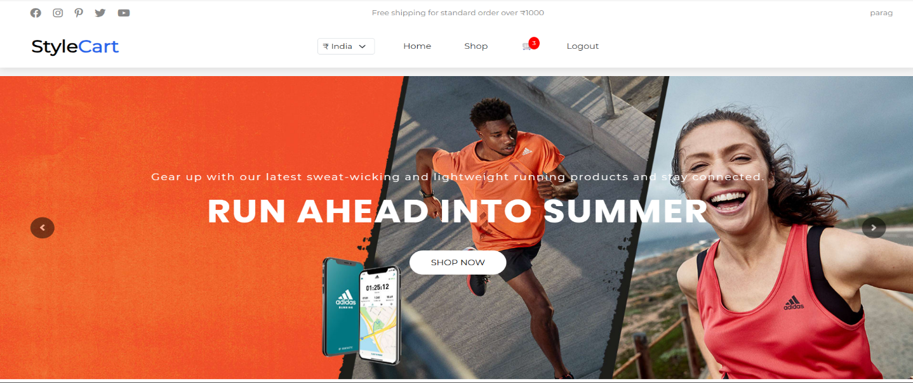
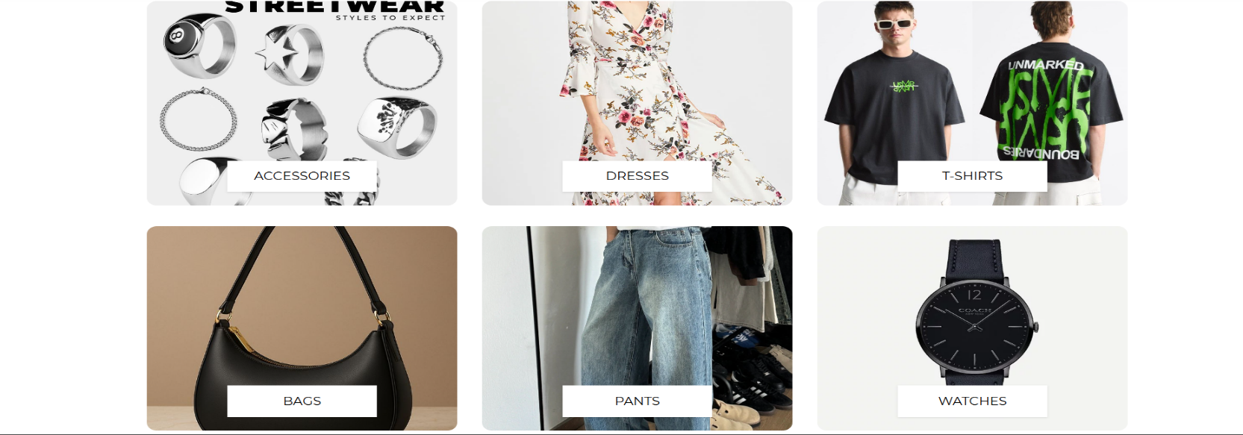
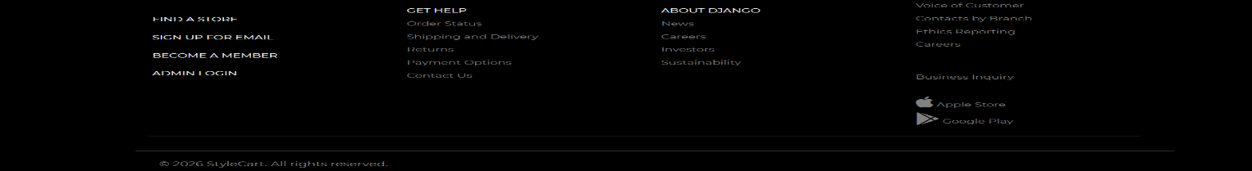
Homepage UI

Slide 8
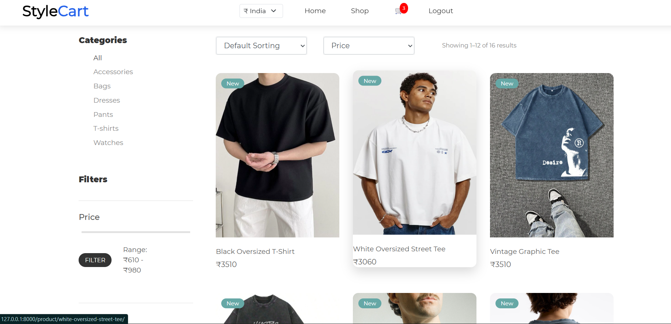
Shop Section

Slide 9
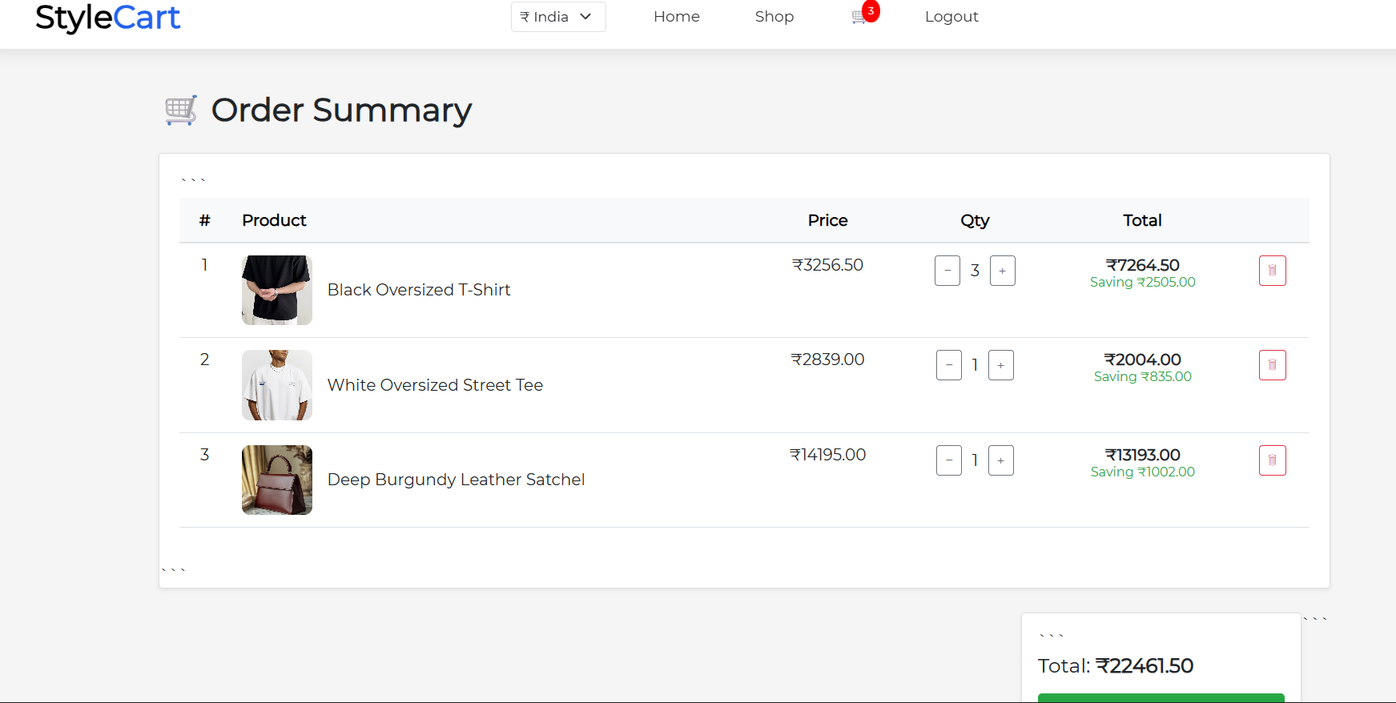
Cart Section

Slide 10
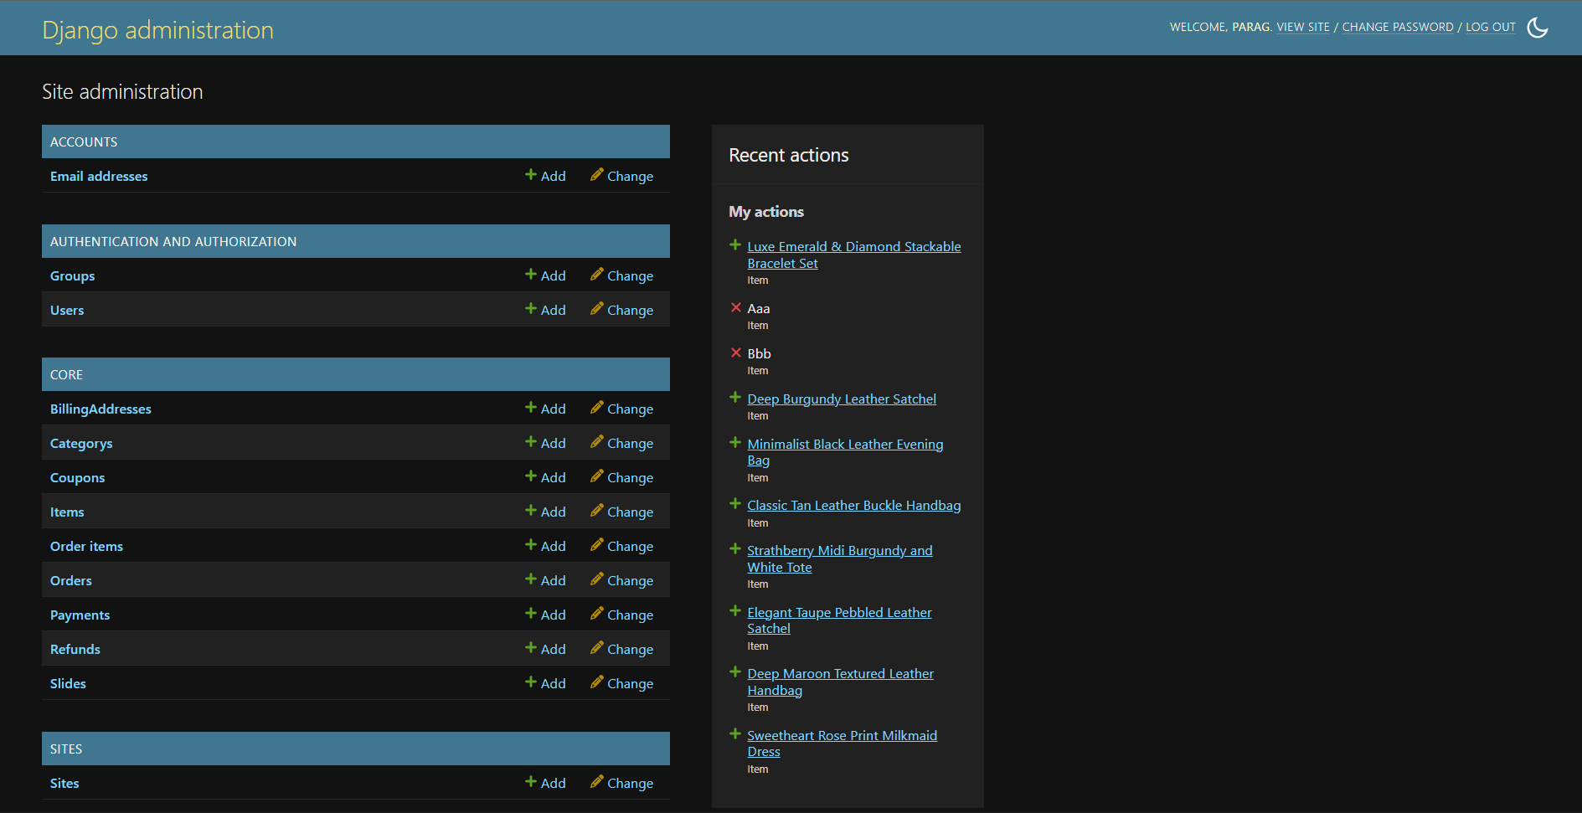
Django Administration

Slide 11
Upcoming Features
Payment Gateway Integration Integration with UPI for online payments
Order Tracking System Track order status after purchase
22CS026

Slide 12
Conclusion
Summary:
StyleCart focuses on building a functional e-commerce system using Django.
It demonstrates key features such as product browsing, cart management, and backend integration.
The project provides hands-on experience in full-stack development and simulates real-world online shopping platforms.
22CS026

